Slide 1
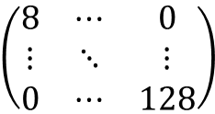
Comparator
Adder
Shifter
Comparator
size in range?
Y
Ceil()
Access
Size Table
Access free list
Borrowing?
free list empty/ full ?
N
N
Y
return pointer
bitwise AND
Y
Shifter
borrow/pay?
Comparator
N
Fallback
$$\left(\begin{matrix}8 & ⋯ & 0 \\ ⋮ & ⋱ & ⋮ \\ 0 & ⋯ & 128\end{matrix}\right)$$
…
Size | Base Address
16 | 0x3100FCDE
32 | 0x3400AC92
…
free list
…
free list

